Slide 1

Franchise Index Research Summary
OFFICE 858.935.6041
DIRECT 858.461.8183
MOBILE 619.838.8533
EMAIL info@eqmindexes.com
WEB eqmindexes.com
TWITTER @eqmindexes
February 2018

Slide 2
Franchise Index Screen
Universe of US and Canada Franchise Names
Market Cap >=$100 million USD
Minimum Price >= $3 USD
Turnover/Traded Value = $1m
Historical Screen Counts
Date | # Names | Turnover (%)
12/31/17 | 52 | 13.97
06/30/17 | 53 | 7.31
12/31/16 | 56 | 18.59
06/30/16 | 58 | 16.95
12/31/15 | 60 | 7.62
06/30/15 | 62 | 6.44
12/31/14 | 56 | 4.80
06/30/14 | 57 | 4.26
12/31/13 | 53 | 5.60
06/30/13 | 55 | 22.23
12/31/12 | 49 | 9.15
06/30/12 | 48 | 3.65
12/31/11 | 46 | 9.28
06/30/11 | 45 | 14.31
12/31/10 | 43 | N.A.

Slide 3
Franchise Index Backtest Parameters
7 Year Backtest Period
Semi-Annual Rebalance
Rules Based Fundamentally Weighted
Weighting Factor: ROIC
ROIC - Indicates how effectively a company uses the sources of capital (equity and debt) invested in its operations. Average Invested Capital is the average of the beginning and ending balance of Total Invested Capital (RX215, TOTAL_INVESTED_CAPITAL).
It is computed as:
100 x (T12M Net operating profit after tax / Average invested capital)
Where:
T12M Net operating profit after tax is RX216, TRAIL_12M_NET_OP_PROF_AFTER_TAX
Invested Capital is RX215, TOTAL_INVESTED_CAPITAL
Average of Invested Capital is calculated based on the average of invested capital for current period and invested capital for the same period a year ago.
ROIC will not compute if:
1. The year-over-year average of invested capital is negative.
2. Effective Tax Rate (RR037, EFF_TAX_RATE) or Trailing 12 Months Effective Tax Rate (RR712, TRAIL_12M_EFF_TAX_RT) is not available.

Slide 4
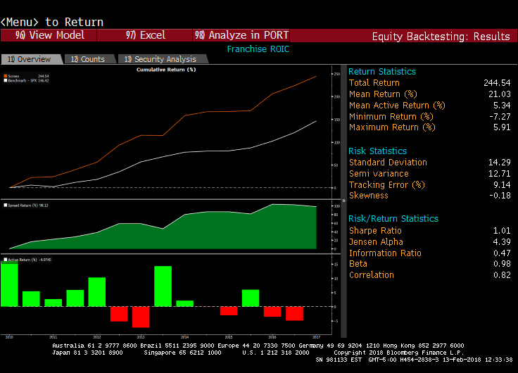
Franchise Index Backtest Results
7 Year Backtest Period
Semi-Annual Rebalance
Rules Based Fundamentally Weighted
Weighting Factor: ROIC

Slide 5
Franchise Index Backtest Parameters
7 Year Backtest Period
Semi-Annual Rebalance
Rules Based Fundamentally Weighted
Weighting Factor: ROIC/WACC Ratio
ROIC/WACC Ratio - WACC Return on Invested Capital (VM013, WACC_RETURN_ON_INV_CAPITAL) divided by Weighted Average Cost of Capital (VM011, WACC).
WACC Return on Invested Capital = Net Operating Profit after Tax (VM027, WACC_NOPAT) / Total Invested Capital (VM031, WACC_TOTAL_INV_CAPITAL)
WACC = [KD * (TD / V)] + [KP * (P / V)] + [KE * (E / V)]
KD = Cost of Debt (VM010, WACC_COST_DEBT)
TD = Total Debt (RR251, SHORT_AND_LONG_TERM_DEBT)
V = Total Capital
KP = Cost of Preferred (VM009, WACC_COST_PFD)
P = Preferred Equity (BS061, BS_PFD_EQY)
KE = Cost of Equity (VM008, WACC_COST_EQUITY)
E = Equity Capital (RR902, CUR_MKT_CAP)

Slide 6
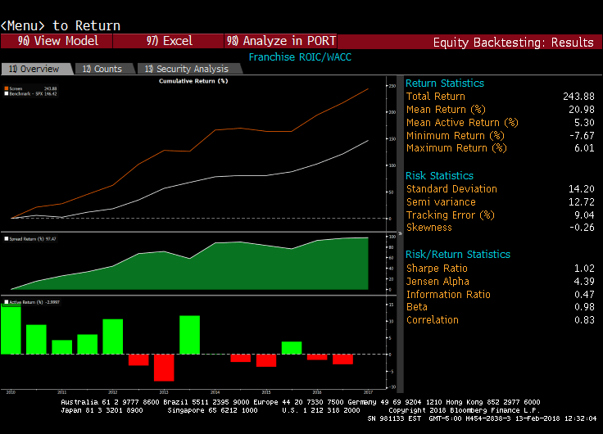
Franchise Index Backtest Results
7 Year Backtest Period
Semi-Annual Rebalance
Rules Based Fundamentally Weighted
Weighting Factor: ROIC/WACC Ratio

Slide 7
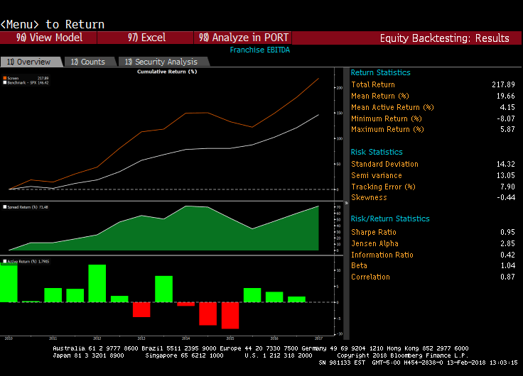
Franchise Index Backtest Results
7 Year Backtest Period
Semi-Annual Rebalance
Weighting Factor: EBITDA Margin

Slide 8
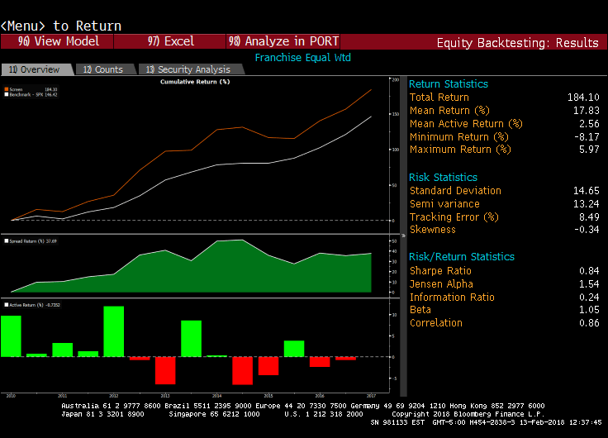
Franchise Index Backtest Results
7 Year Backtest Period
Semi-Annual Rebalance
Equal Weighted

Slide 9
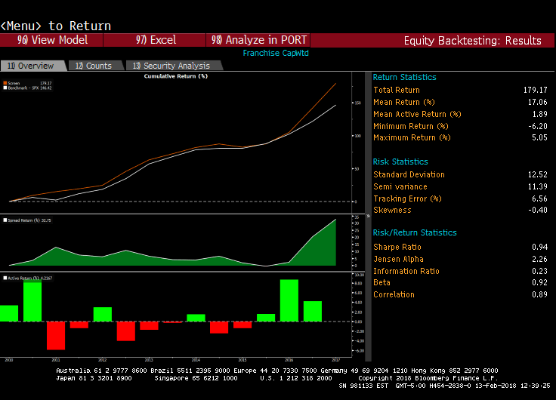
Franchise Index Backtest Results
7 Year Backtest Period
Semi-Annual Rebalance
Cap Weighted

Slide 10
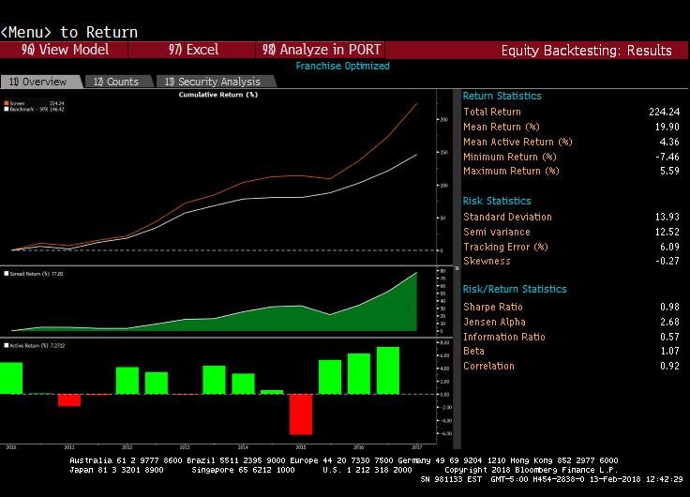
Franchise Index Backtest Results
7 Year Backtest Period
Semi-Annual Rebalance
Optimized Risk/Reward

